Slide 1

Category Code: C3
Problem Statement Title: FinEase: AI-Powered Autonomous Finance for Small Businesses
Team Name: Team INSPIRE
Institute Name: Vivekanand Education Society’s Institute of Technology

Slide 2

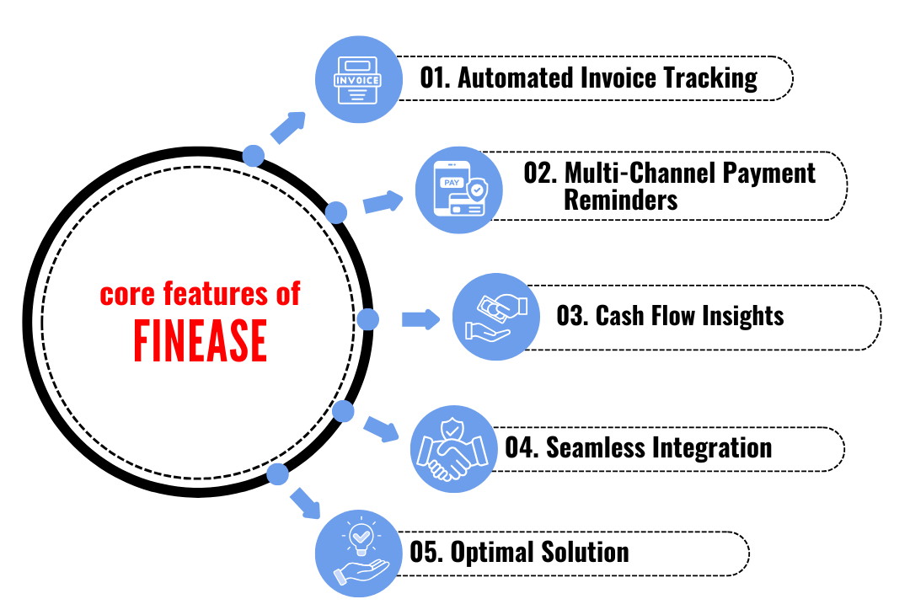
Idea / Approach details (& implemented features)
Problem Statement:
🔹 Small businesses struggle with financial
tracking, late payments, and debt risks.
🔹Traditional tools lack AI-driven insights for
smarter financial decisions.
Our Solution :
🔹 AI-powered financial tracking with real-time
updates.
🔹 Automated invoice generation & reminders
(email, WhatsApp, SMS).
🔹 Debt risk detection & priority-based payment
suggestions.
🔹 Predictive cash flow analysis using VectorDB
& AI.

Slide 3
Innovation (Showstopper)
Feature | Traditional Accounting Apps | FinEase
Invoice Tracking | Manual logging | Automated fetching & overdue detection
Reminders | Basic alerts | Smart multi-channel reminders (SMS, Email, WhatsApp, Slack)
Cash Flow Analysis | Manual input | AI-driven financial insights & forecasting
Integration | Limited | Seamless sync with QuickBooks, Xero, Zoho Books
Autonomy | User-dependent | AI-powered financial assistant
Unlike traditional accounting apps, FinEase is an AI-powered financial assistant that automates invoice tracking, detects overdue payments, sends smart reminders, and provides cash flow insights—minimizing manual effort.

Slide 4
Tech Stack
🔹 GenAI Models – GPT-4o for AI-powered financial insights
🔹 Frontend – ReactJS
🔹 Uptiq AI Workbench – For agent creation & workflow automation
🔹 Vector DBs – For data storage and transaction tracking
🔹 Twilio / Meta API – For SMS, WhatsApp, and email notifications
🔹 Razorpay / PayPal API – For automated supplier payments

Slide 5
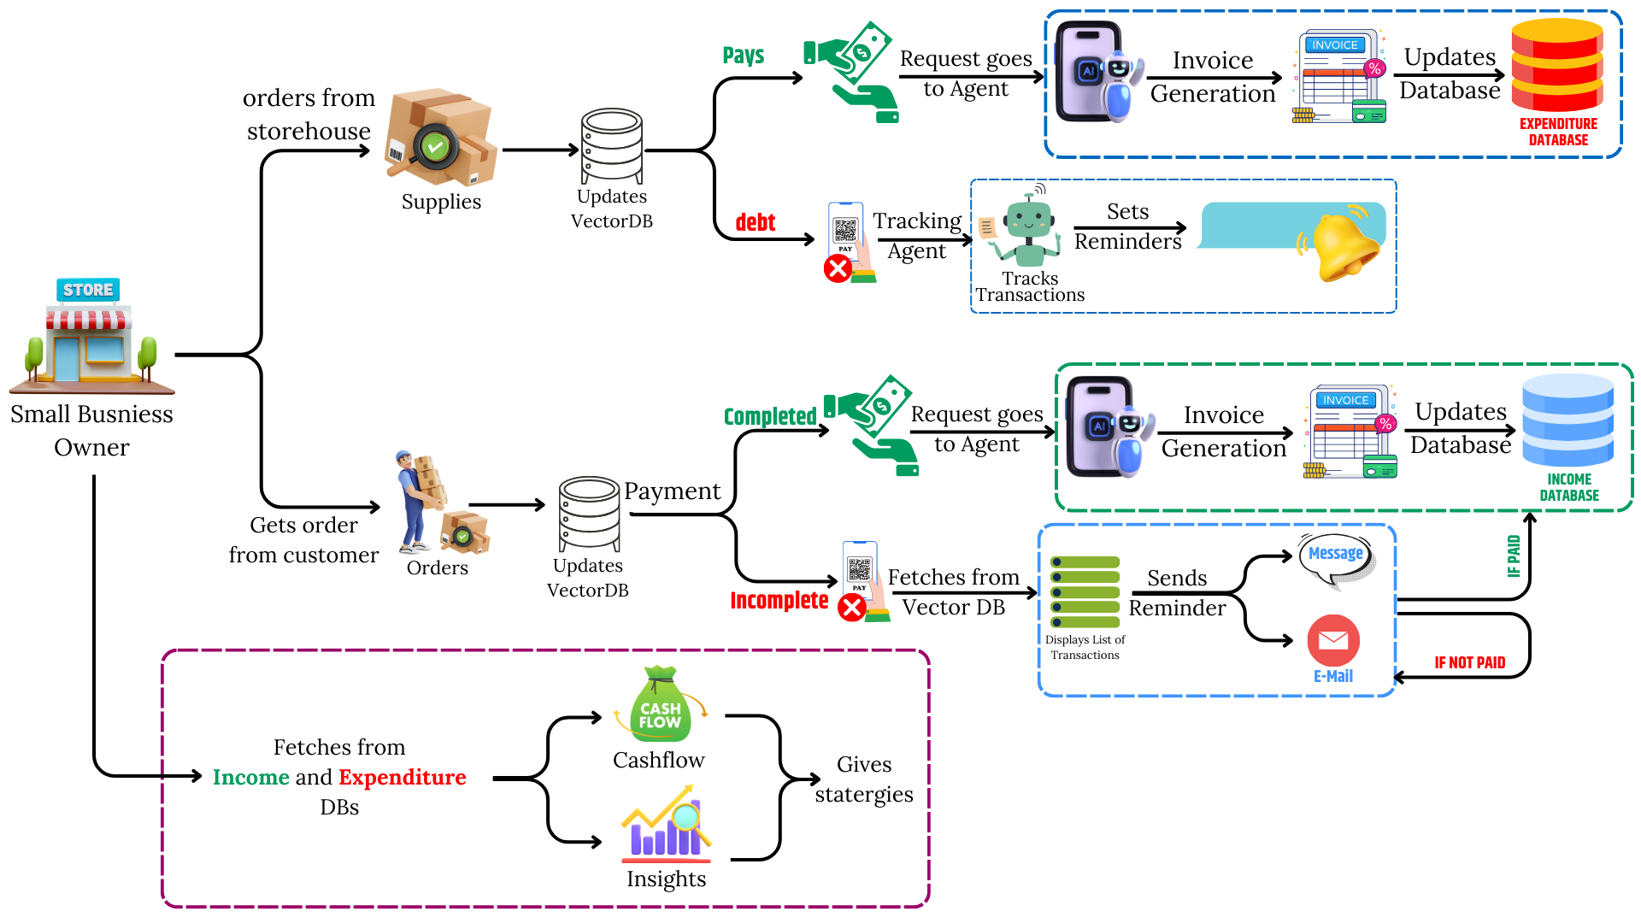
Implementation/Prototype/Use Case Diagram (screenshots)
Use Case Diagram
Documentation: Link

Slide 6
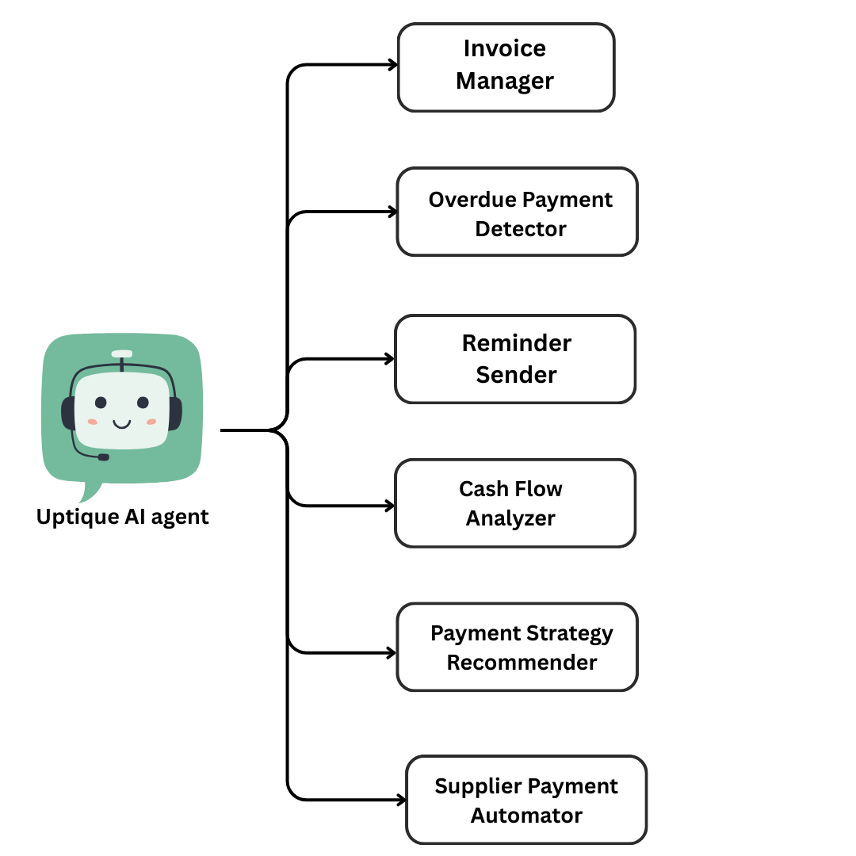
In case of Uptiq category - Your Uptiq Agent (explain in detail)
- Organizes and tracks all invoices, ensuring seamless financial management.
- Identifies late payments and flags them for quick resolution.
- Automatically notifies users and clients about pending payments via multiple channels
(Email, Slack,etc).
- Uses AI to assess financial health and predict cash flow trends based on Income
and Expenditure
- Suggests optimal payment schedules and methods for better financial stability.
- Automates recurring supplier payments to improve efficiency and avoid delays.

Slide 7
Feedback Received
Analyzing the each feature and providing real statistics.
Ideating Scalable Business plan.
Progressing on next steps

Slide 8
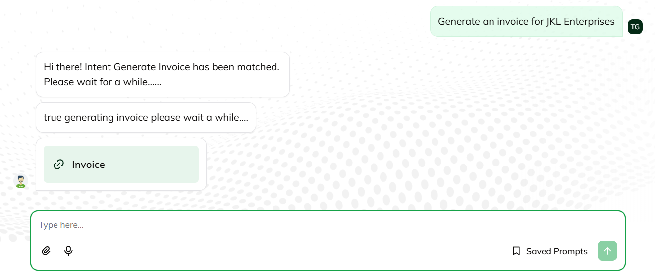
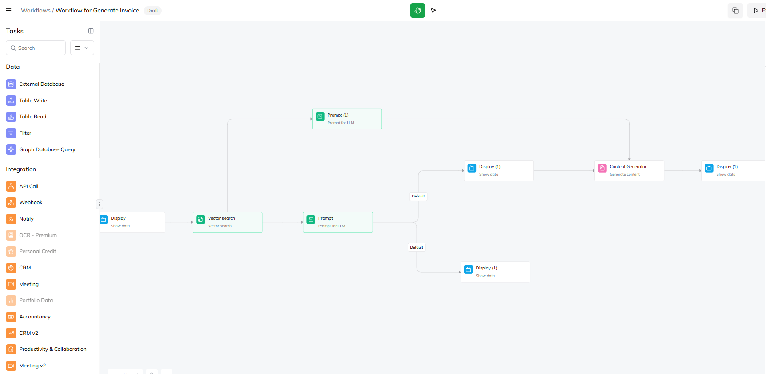
Detailed Implemented Features
Automated Invoice Tracking
FinEase automates invoice retrieval, detects overdue payments, and reduces manual effort, ensuring seamless financial operations.
Why It Is Needed
Reduces manual effort, minimizes errors, prevents overdue payments, and ensures smooth cash flow with timely tracking.
UI to access and configure Invoice
Implementation
✔ Connect–Connect to Vector Database. ✔ Parse – Vector AI extracts due dates, amounts, and vendors. ✔ Validate – Structure and verify invoice data. ✔ Automate – Categorize & gives downloadable Invoice.

Slide 9
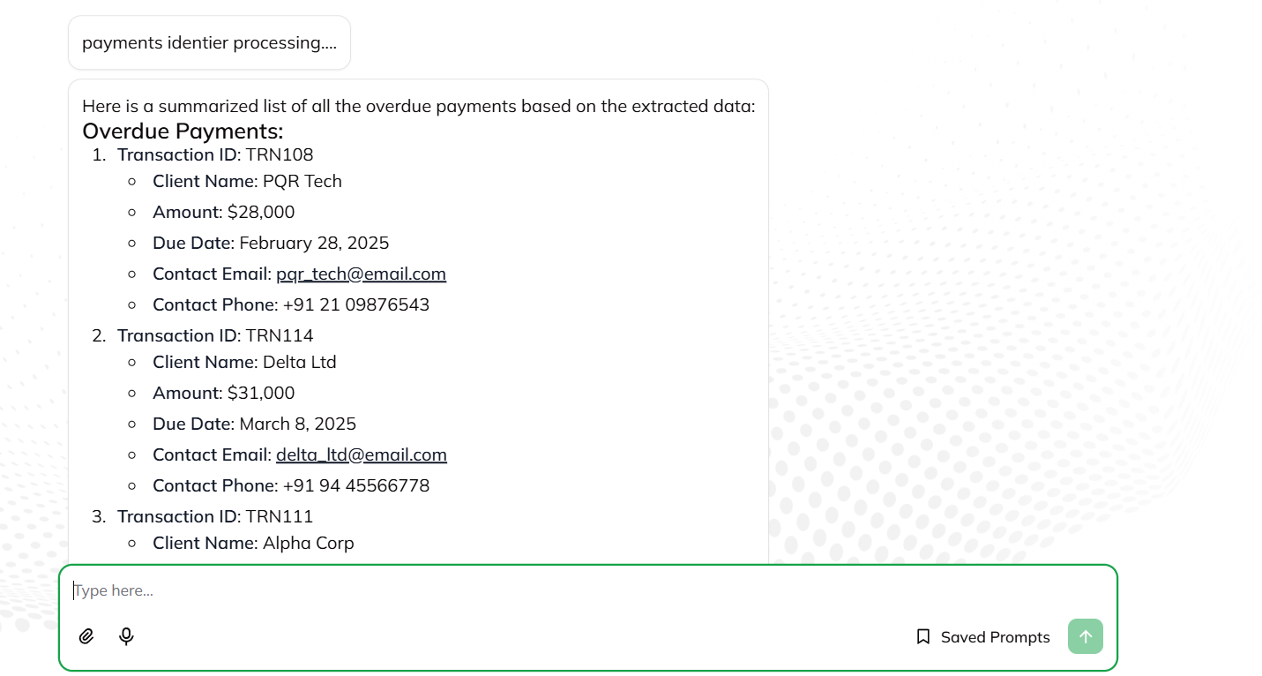
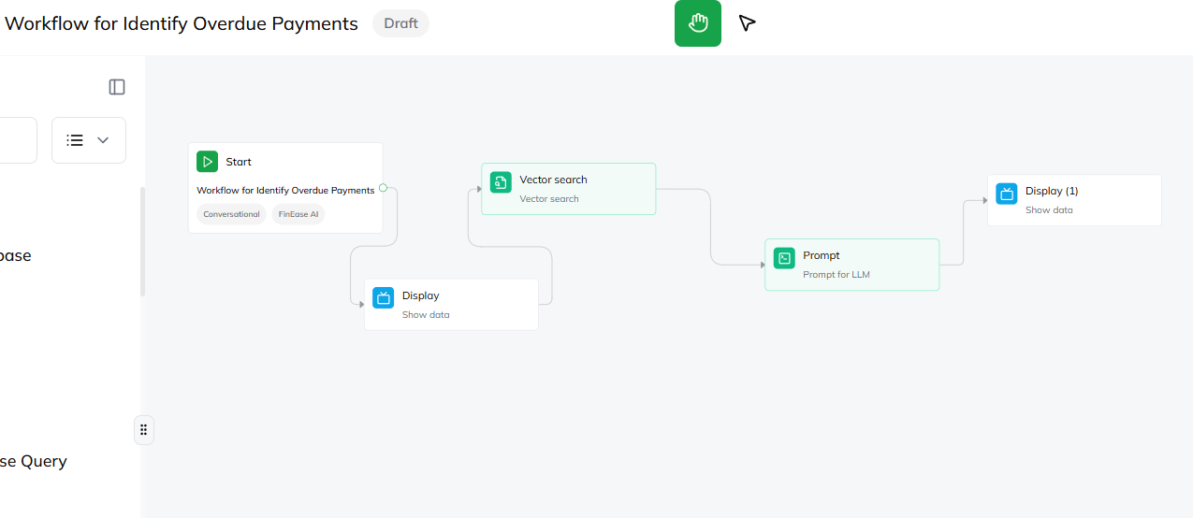
Detailed Implemented Features
2. Group Users Retrieval (Overdue, Paid and Unpaid)
Automatically classifies users based on their payment status (Paid, Due, Overdue) for streamlined financial monitoring.
Why It Is Needed
Ensures businesses can track outstanding payments, reduce late receivables, and maintain a healthy cash flow.
Implementation
✔ Fetch Data – Retrieves invoice records from vector db.
✔ Classify & Organize – AI categorizes invoices by status, detecting overdue and unpaid invoices.
✔ Trigger Actions – Sends automated reminders and updates for pending or overdue payments by integrating to reminder node.
Node structure for Users Retrieval

Slide 10
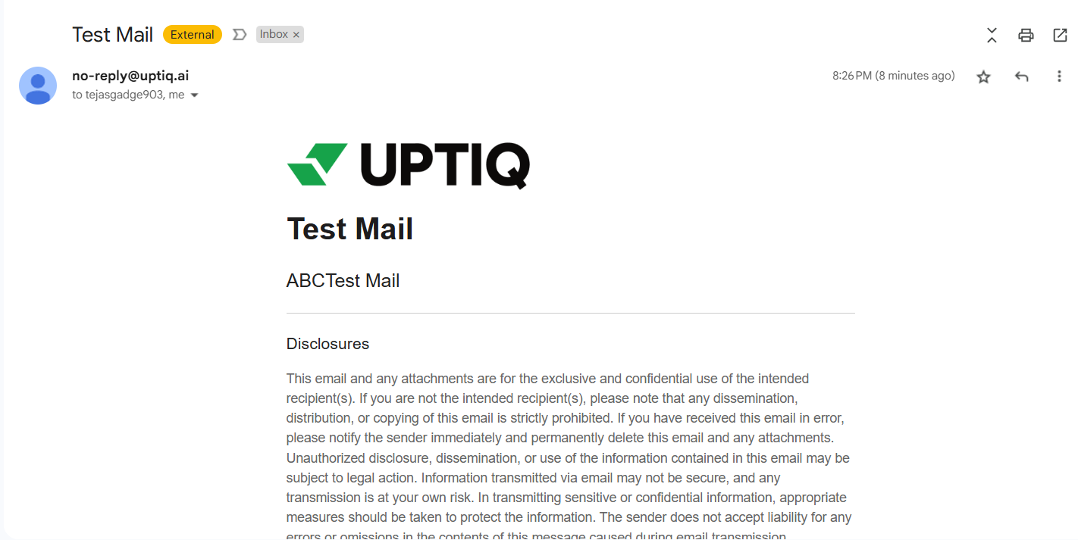
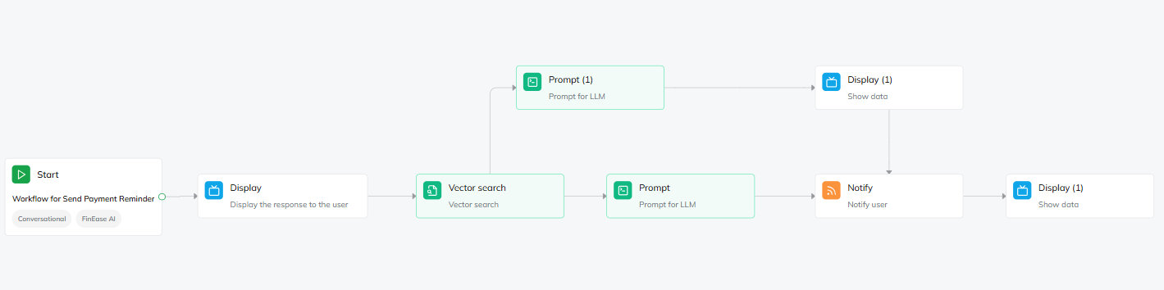
Detailed Implemented Features
3. Automated Reminders (Email)
Automatically sends email reminders to clients for pending and overdue invoices, reducing delays and ensuring timely payments.
Why It Is Needed
Reduces manual follow-ups, minimizes late payments, and improves cash flow management.
Implementation
✔ Invoice Tracking – Monitors due dates and payment statuses from integrated accounting systems.
✔ Retrieval: Users with overdue or pending payments.
✔ Automated Dispatch – Sends reminders at predefined intervals until payment is received using notify Node.

Slide 11
Statistics
Feature | Traditional Accounting Apps | FinEase
Invoice Processing Time | 7 to 13 days | 3-4 days , where 50% or greater time savings than manual .
Accuracy | Between 0.04% to 12% | 75% percent fewer error rates.
Cost Report | High costings | 78.8 - 83 % cost reduction.
Savings | Approximately ₹110 per invoice | Approximately ₹40 per invoice , reduce costs by 60% to 90%
Cash Flow Forecasting | Approx 72% data is manually collected so high error rates. | 20% improvement in forecasting accuracy.
Environmental Impact | 70% of paper invoices used | Minimal paper usage

Slide 12
Business Model
Target Users (Who will use it?)
🔹 Small & Medium Enterprises (SMEs) – Businesses that need automated invoicing and payment tracking. 🔹 Freelancers & Consultants – Individuals managing their own finances and payments. 🔹 Large Enterprises – Companies integrating with QuickBooks, Xero, or Zoho Books. 🔹 Accountants & Financial Advisors – Professionals who manage multiple client accounts.
Scalability Options (How will it grow?)
🔹 Expand to Global Markets – Support for multiple currencies & tax systems. 🔹 Custom Workflow Automations – Personalized invoice & payment rules for different industries. 🔹 Voice Assistants – Voice-based finance tracking . 🔹 Partnerships with Banks & FinTechs – Seamless banking integrations for direct payments.

Slide 13
Future Objectives
Seamless User Authentication – Enable login via OAuth (Google, QuickBooks, Xero, etc.) or manual registration for a frictionless onboarding experience.
Voice-Enabled Financial Assistant – Allow users to query reports, track invoices, and receive insights through voice assistants for hands-free convenience.
Customizable Payment Workflows – Businesses can set tailored rules for reminders, follow-ups, and invoice tracking to fit their financial operations.
Automated Payments via Gateways – Integrate UPI, Stripe, Razorpay, and more to facilitate direct, automated invoice payments and reduce delays.

